Slide 1
VSCode Plugin Development for Automotive App Deployment
Software Engineering Project – Team Bosch.IO
Leipzig, 28.09.2023
Maximilian Nerlich, Carlo Pötter, Martin Hoffmann & Leonardo d‘Angelico

Slide 2
PROJECT OUTLINE – SETUP, GOALS & OUTCOME
Team Bosch.IO

Slide 3



PROJECT OUTLINE
Software Engineering Project | Team Bosch.IO
SETUP: ROLE OF BOSCH.IO & ECLIPSE FOUNDATION
SEP PROJECT TEAM
Bosch.IO as Mediator between Us & Eclipse Foundation
Bosch.IO has strategic Open Source Collaboration
We develop in Context of Eclipse Foundation
Role of Bosch.IO: Mentoring, Project Mediation, Tech. Guidance
Dr. Kristan: Direct Contact Person & PO; M. Grzanna = Tech. Assistance
Notes:
=> We interact with Bosch.IO

Slide 4
PROJECT OUTLINE
Software Engineering Project | Team Bosch.IO
SETUP: ROLE OF BOSCH.IO & ECLIPSE FOUNDATION
SEP PROJECT TEAM
Eclipse Foundation as Industry Open Source Incubator
Industry Standards & Hub for strategic Open Source Innovation
Embraced by Industry Leaders (like e.g. Bosch.IO)
Carries Eclipse IDE, Jakarta EE (for JAVA), and 400+ Open Source Projects

Slide 5
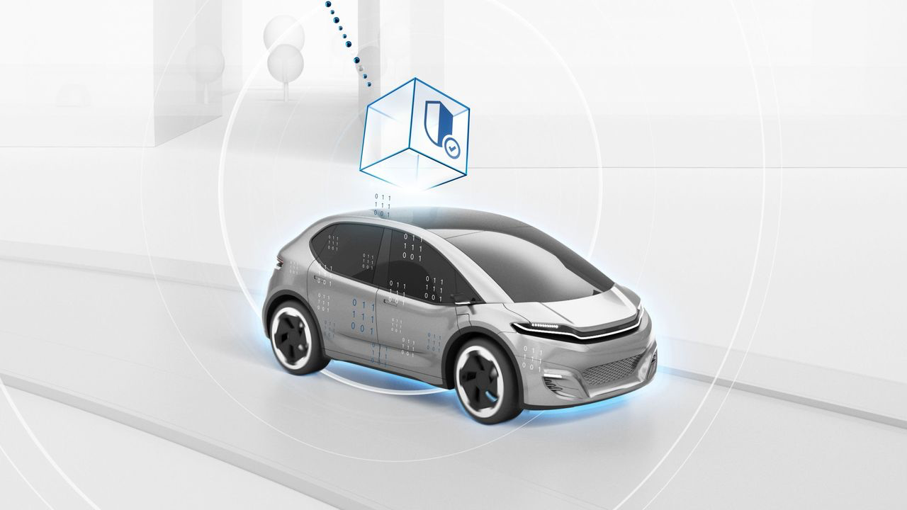
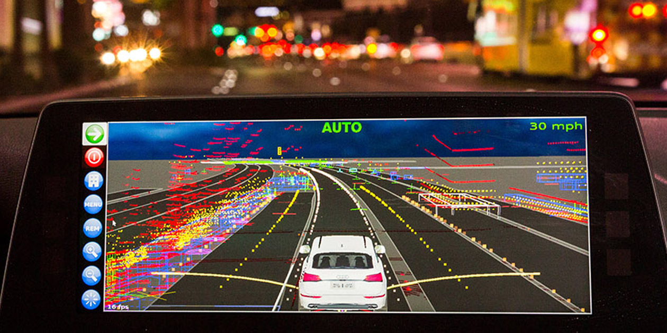


PROJECT OUTLINE
Software Engineering Project | Team Bosch.IO
OUR ROLE: WE CONTRIBUTE IN ECLIPSE PROJECT: „LEDA“
Eclipse Leda: Technology Ecosystem for Software-Defined-Vehicles (SDV)
Aims to bring various SDV-Components together in Optimization
Linux Distro (OS) with Tool Stack to deploy Apps on Vehicles (Vehicles as „Computer“)
Vehicle App
deploy
run

Slide 6
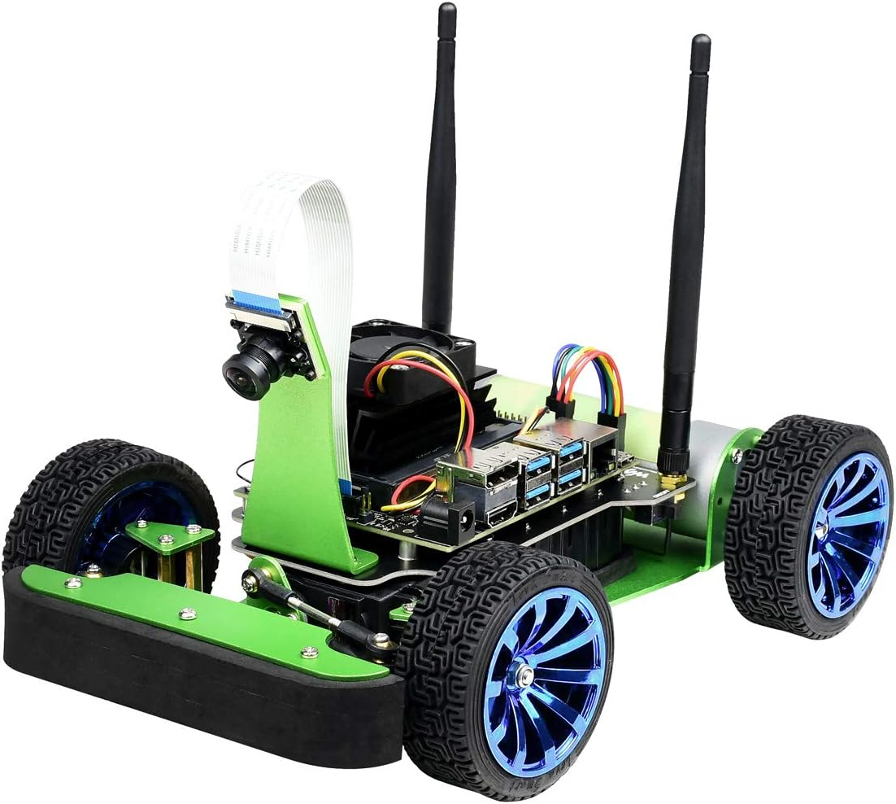



PROJECT OUTLINE
Software Engineering Project | Team Bosch.IO
THE PROJECT GOALS
A
B
C
A. Reshape inefficient „old“ Deployment Process
Melt new Deployment Process into VSCode Plugin
Test Hardware & VSCode Plugin on Jetson Nano that runs Leda

Slide 7
PROBLEM SPACE
Software Engineering Project | Team Bosch.IO
TWO FLAWS IN „OLD“ SDV DEPLOYMENT PROCESS
Manuel Configuration on Vehicle (via SSH)
Multiple Dependencies
Time Overhead
Advanced Infrastructure Knowledge needed
Internet
Error-intense
Remote Build Tools

Slide 8
SOLUTION SPACE
Software Engineering Project | Team Bosch.IO
VSCODE PLUGIN TO EASY TRIGGER NEW DEPLOYMENT PROCESS
Manuel Configuration on Vehicle (via SSH)
Solution
Deployment in IDE via VSCode Plugin
Reshaped Process internalizing container-build (no internet required)
Solution
Multiple Dependencies

Slide 9

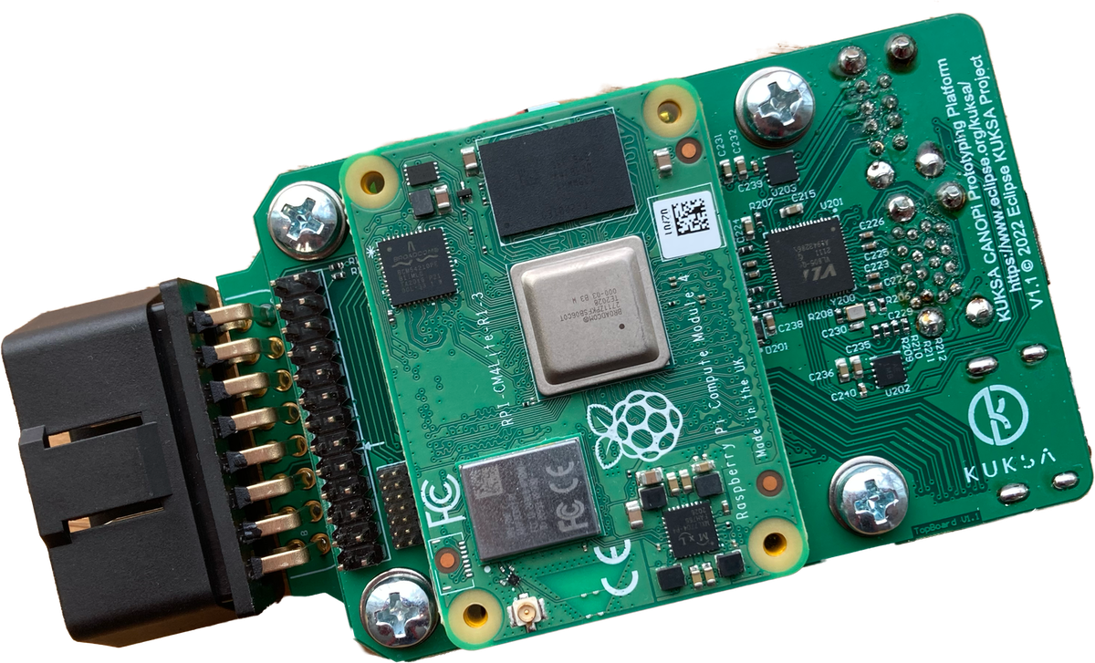




OUR DEPLOYMENT PROCESS
Development Flow Today
5. Download container image
MQTT
Software Engineering Project | Team Bosch.IO
2. Build image
local
4. Start container
Vehicle App
1. Develop In-Vehicle-App
3. Copy Image via local network

Slide 10
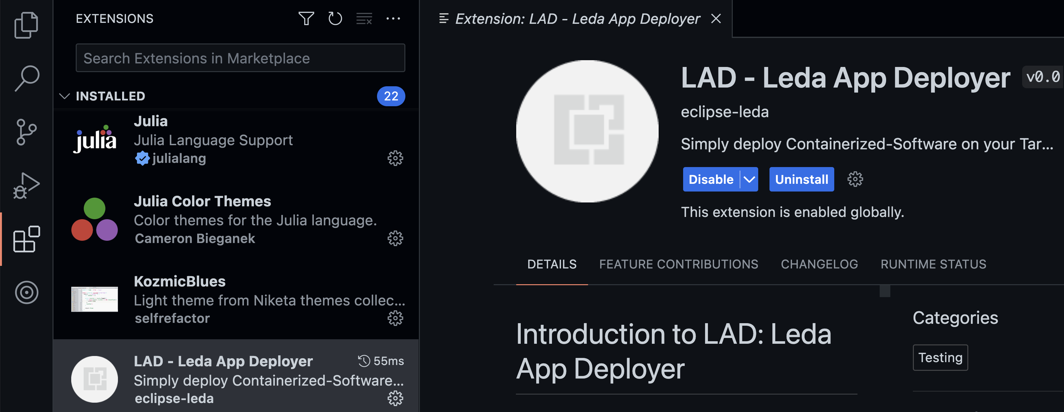



LEDA APP DEPLOYER (LAD)
Software Engineering Project | Team Bosch.IO

Slide 11
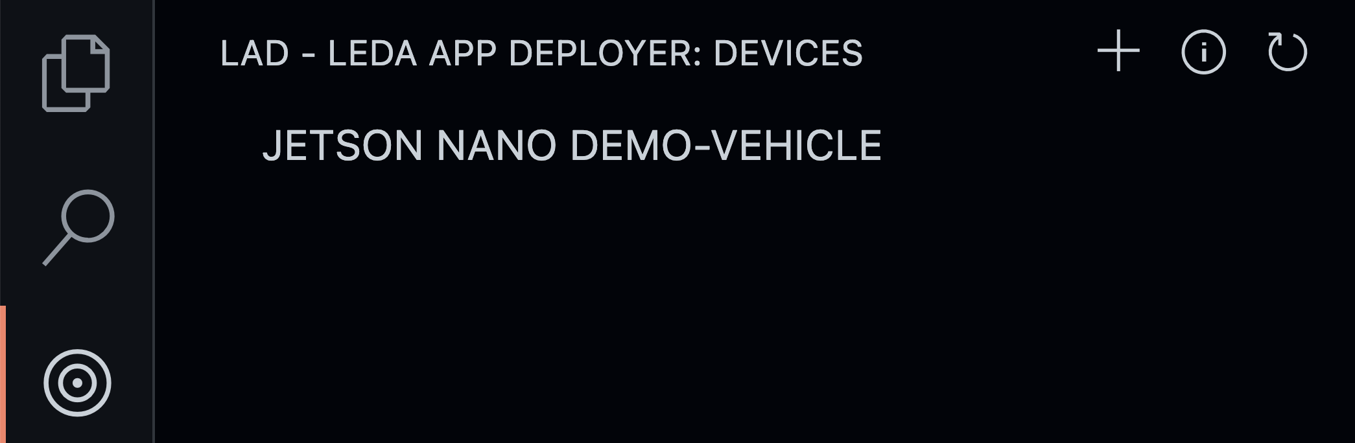


LAD IN ACTION
Software Engineering Project | Team Bosch.IO
Emulate Vehicle in Virtual Machine (QEMU)
Leda is not running on its ARM64!

Slide 12


PROJECT OUTLINE
Software Engineering Project | Team Bosch.IO
PROJECT OUTCOME & DEVIATION
A
B
C
➔ Deviation: We could still run Tests with Emulation (QEMU)

Slide 13
ORGANISATION: HOW WE MANAGE THIS PROJECT
Team Bosch.IO

Slide 14




ONBOARDING WITH BOSCH.IO
Software Engineering Project | Team Bosch.IO
DEFINE PROJECT FRAME & SELECT PROJECT MANANGEMENT TOOLSTACK
Support from Bosch.IO:
Clarification of Project Insights (as shown)
Communication of Required Skills & Technical Guidance, EPICS
Contact to Project Leda Developers (Eclipse Foundation)
Team Model Canvas to Define Outlines
Define SCRUM as Framework & adapt it to our needs
Definition of our Communication & Project Management Tool Stack
Notes:
- Team Model Canvas:
- Strength, Weaknesses
- Goals, Expected Outcome
- Value we create = WORKS GOOD FOR TEAM BUILIDING
TOOLS:
- DISCORD: Main communication channel ➔ Good: Screenshare (Pair-Programming) and Chat
- MS-Teams: Communication Bosch.IO-related ➔ Used because: it is their company communication service
- Confluence: Where we store our Documentation ➔ Used as free WIKI
- GitHub:
- ISSUES: Track our SCRUM-Related things in a Board (present later on)

Slide 15
PROJECT MANAGEMENT VIA SCRUM
Software Engineering Project | Team Bosch.IO
3 Roles
PO (Dr. Kristan)
Dev Team
Scrum Master
3 Artifacts
Product Backlog
Sprint Backlog
Product Increment
5 Events
Sprint
Sprint Planning
Daily Scrum
Sprint Review
Sprint Retro
Notes:
WHY SCRUM: - Best Practice, …
clarification of project environment:
- already talked about in the beginning
Support from Bosch.io:
- contact to Eclipse
- Developer meeting with presentation of Plugin
- Project Management tool suggestions
- team model canvas to get started
- SCRUM as framework
communication of required skills
- required skills were partly communicated by max and johannes

Slide 16
SCRUM „LITE“ – OUR ADAPTION
Software Engineering Project | Team Bosch.IO
3 Roles
PO (Dr. Kristan)
Dev Team
Scrum Master
3 Artifacts
Product Backlog
Sprint Backlog
Product Increment
5 Regular Events
Sprint
Sprint Planning
Daily Scrum
Sprint Review
Sprint Retro
Preparation Sessions
Dev Presentations
Sprint Backlog
Activities
Sprint 14 Days
Dev Presentations
Product Backlog
Preparation
Shippable
Increment
Review
Notes:
Deviation:
- Roles: Dev Team is everyone (SM and the others)
- Events:
- NO Daily ➔ Time-Constraints
- NO Retro ➔ Not useful: Good Sentiment overall, problems tackled in Review)
- BUT Prep Sessions every week before Scrum Meetings ➔ Necessary to keep sync
- BUT Presentations for Leda Team (Necessary)
➔ Overall: We kept out basic routines
@ After the flow appeared @
- INTERACTIONS ➔ We in Team (Pair Programming, Discord, Live Coding together)
We with Johannes in Sprint Planning, Review
We with other Devs from Leda in Dev Presentation)
-

Slide 17
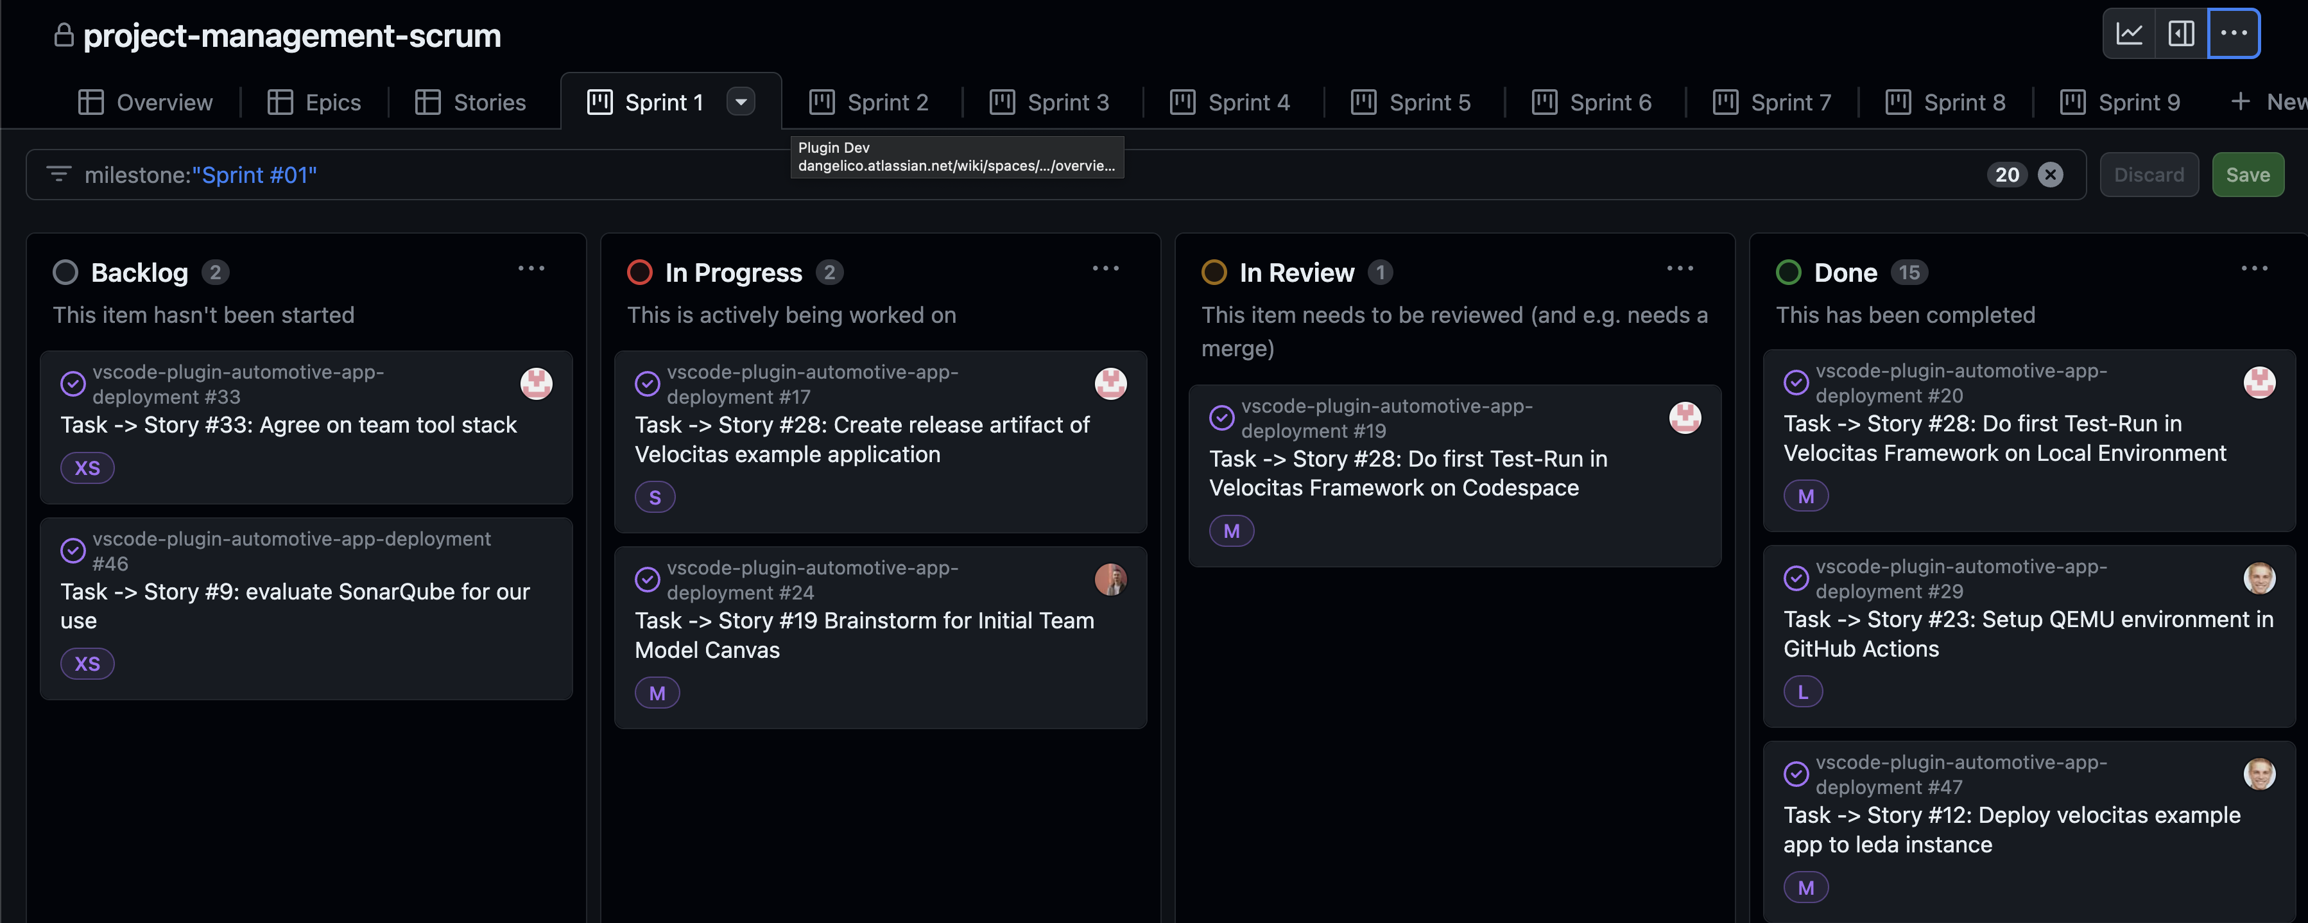
MANAGE SCRUM WITH GITHUB ISSUES BOARD
Software Engineering Project | Team Bosch.IO
Notes:
The good:
Already in our Dev-Environment
Linking Pull Requests to Tickets
We all have already accounts in GitHub
Free
The bad:
Not tailored for Scrum
E.g. No explicit Subdivision from Epics -> Stories -> Tasks,
Solution: See board (Linking via Labels (Epics) and Naming

Slide 18
DEVELOPMENT WORKFLOW, ENVIRONMENT & TYPICAL ISSUES
Team Bosch.IO

Slide 19
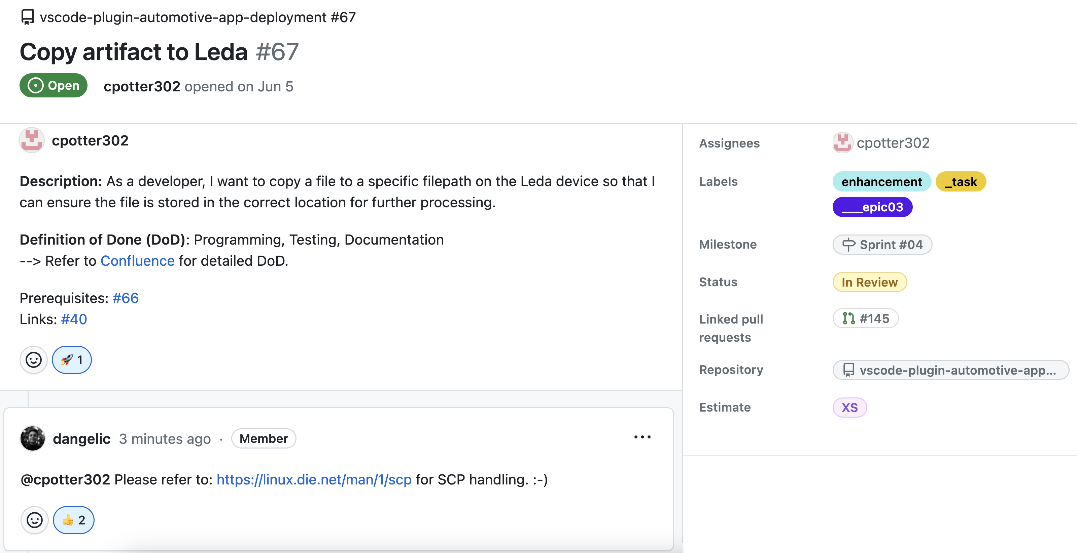
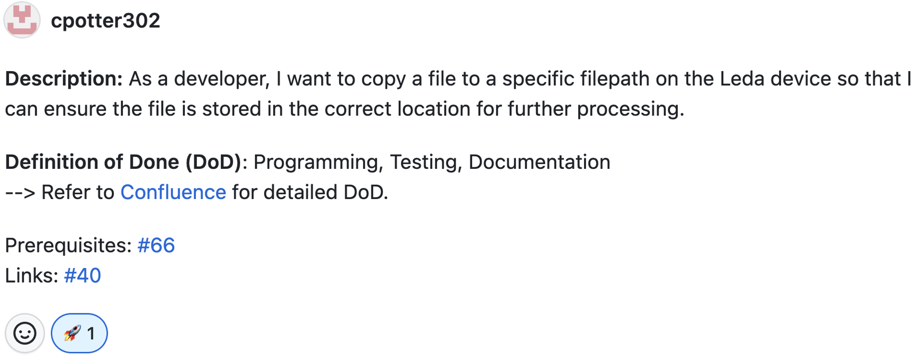
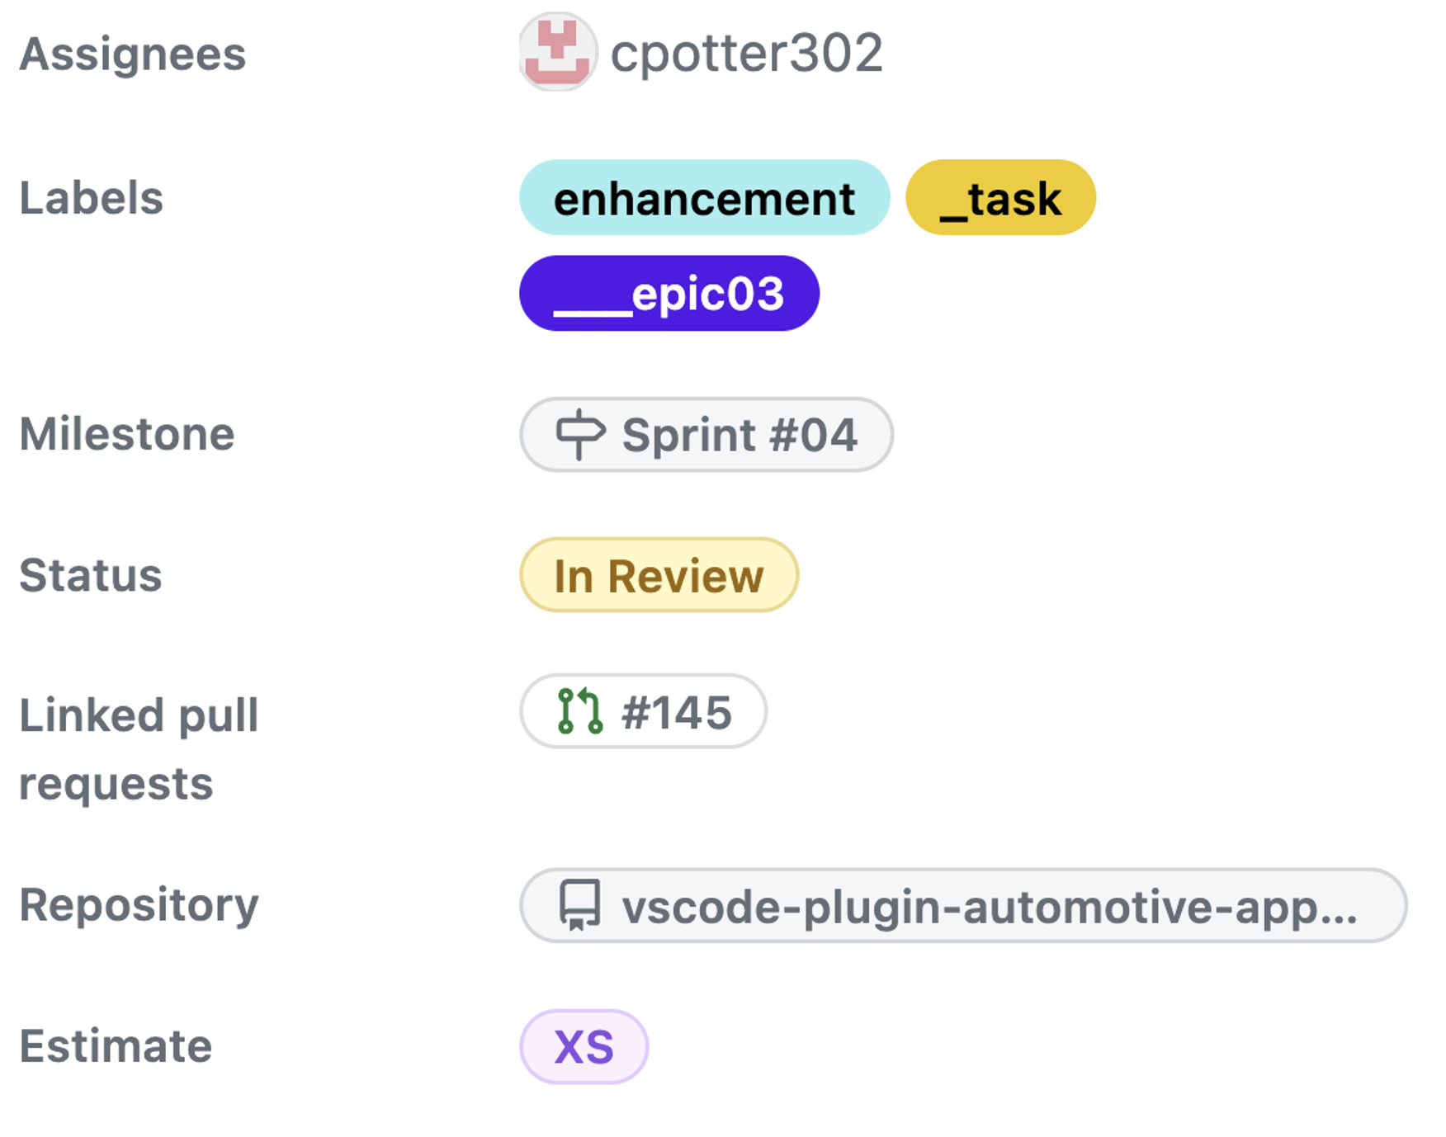
Software Engineering Project | Team Bosch.IO
Code Quality

Slide 20


OUR IDEAL DEVELOPMENT WORKFLOW
Software Engineering Project | Team Bosch.IO
Write Ticket (BOARD)
Sight Ticket
Implement & Test Feature
Commit & push
Trigger
GitHub- Actions
Open PR
Review PR
Merge PR
Notes:
IMPLEMENTATION TOOLS
- Docker, CLI-Tools, JEST
PIPELINE: - TEST AND BUILD

Slide 21
TYPICAL ISSUES
Software Engineering Project | Team Bosch.IO
DEVIATION FROM OPTIMAL PROCESS
Implement & Test Feature
Ticket Definition & Communication Issues
Ticket is vagely defined
Estimation not precise enough
Long Review Phases (for PR)
Technical Issues
Fail of Tests or CI/CD Pipelines
Merge Conflicts
Fail of Tests / CI/CD Pipelines
False Review → Bugs on Master Branch
Feature is not implementable
Trigger
GitHub- Actions
Write Ticket
Review PR
Merge PR

Slide 22




DEVELOPMENT TOOL LANDSCAPE
Software Engineering Project | Team Bosch.IO
IDE / Code-Editor
DEV-Suite for VSCode Plugin
Creating Architecture Diagrams
Interface for Container Builds
Command Line Tools (e.g. Docker CLI, Leda CLIs, …)
Actions: Pipeline (Source > Build > Test)
Configuration Management
Test Framework (Unit-Tests)
Code Version Management
Release-Pipeline & Management
Notes:
IMPLEMENTATION TOOLS
- Docker, CLI-Tools, JEST
PIPELINE: - TEST AND BUILD

Slide 23
BIGGEST CHALLENGE, HIGHLIGHT & KEY LEARNINGS
Software Engineering Project | Team Bosch.IO
Team Bosch.IO

Slide 24


BIGGEST Challenge: BECOME PROJECT-COMPLIENT
Software Engineering Project | Team Bosch.IO
COMPLIENCE FOR THE LEDA OPEN SOURCE CONTRIBUTION
Code Compliance
… become a Repository under Project Leda
Legal Compliance

Slide 25
BIGGEST Challenge: BECOME PROJECT-COMPLIENT
Software Engineering Project | Team Bosch.IO
CODE Compliance: Source Code has to follow specific project standards.
Code Quality
Style Conventions
Security Standards
Maintainability
Code Quality
Style Conventions
Security Standards
Maintainability
✓ Refactor to TS Clean-Code Guidelines
✓ Use OOP-Design Principles, separate Duties
✓ Use Formatter, Linter & Pre-Commit-Hooks
✓ Emphasize Code Documentation & Readme
✓ Install Dependency Weakness Checker
✓ Seek help: Get Reviews from PO
Notes:
CODE QUALITY: Language Best Practices, KISS,
STYLE CONVENTION: Naming Conventions, Consistent Formatting
SECURITY STANDARDS: Safe Dependencies and Libraries, Security Design Patterns
MAINTAINABILITY: Important because other contributors must understand the logic

Slide 26
BIGGEST Challenge: BECOME PROJECT-COMPLIENT
Software Engineering Project | Team Bosch.IO
LEGAL Complience: Code has to follow Open Source Licensing Guidelines.
Contribution License Agreement
Software Licensing
Dependency Licences
Legal Document Stack
Contribution License Agreement
Software Licensing
Dependency Licences
Legal Document Stack
✓ Get familiar with Apache 2.0 and MIT
✓ Sight & Implement Project Rules
✓ Replace / Remove incomplient libraries
✓ Use related Leda Projects as Blueprint
✓ Request Dependency Scan by Eclipse
✓ Seek help: Get assistance from PO

Slide 27
BIGGEST HIGHLIGHT: WE WILL BE PART OF LEDA
Software Engineering Project | Team Bosch.IO
… AND THE PROJECT DOES NOT END HERE FOR US
SDV as Future-proven Domain
We simplify SDV Development
But Plugin not tested on Field
Further Development required ➔ We keep Maintaining!
Code Compliance
Legal Compliance

Slide 28
CONCLUSION: WHAT WE HAVE LEARNED
Software Engineering Project | Team Bosch.IO
WE COULD ALL ENHANCE OUR SKILLSET IN THIS PROJECT
Technical Perspective
SDV-Development & Toolstack (Leda Environment)
Working in incubating Hightech Project
Development of VSCode Plugin
Project Management Perspective
Collaborative Toolstack on GitHub
Projects with multiple Parties (University, Bosch.io, Leda)
Most important: Team & Time Management
The Open Source Perspective
Code Guidelines
Most unexpected: Various Legal Guidlines & Processes
Notes:
* INCUBATING: We learned that some crucial dependencies might not work in the project

Slide 29
Team Bosch.IO thanks you for the attention! – Q&A
Carlo Pötter, Maximilian Nerlich, Martin Hoffmann & Leonardo d‘Angelico
MSc. Business Information Systems
https://github.com/software-engineering-project-org

Slide 30
TRENNUNG
Software Engineering Project | Team Bosch.IO
AB HIER FOLIEN HINZUFÜGEN

Slide 31
Project Operations & Organisation
xxx
S
X
5 min ca.

Slide 32
Project Operations & Organisation
xxx
S
X
5 min ca.

Slide 33
Textformate
ALLGEMEIN
Fließtext: Schriftgröße 18pt, Zeilenabstand einfach, Schwarz
Aufzählung ab 2. Ebene: Schriftgröße 16pt, Zeilenabstand einfach, Schwarz
Kopf- und Fußzeile: Schriftgröße 12pt, Zeilenabstand einfach, Schwarz
Seitenzahl: Schriftgröße 9pt, Zeilenabstand einfach, Rot
Datumsangabe: Schriftgröße 16pt, Zeilenabstand einfach, Schwarz

Slide 34
Textformate
TABELLEN
Tabellenkopf: Schriftgröße 14pt, Zeilenabstand einfach, Grau (50 % Schwarz)
Erste Spalte: Schriftgröße 14pt, Zeilenabstand einfach, Schwarz
Tabellenangaben: Schriftgröße 12pt, Zeilenabstand einfach, Schwarz
Rahmenlinien: 1pt Grau (50 % Schwarz) und 0,5pt Grau (50 % Schwarz)
 | Tabellenkopf | Tabellenkopf | Tabellenkopf
Wert | Wert | Wert | Wert
Hervorhebung | Wert | Wert | Wert
Wert | Wert | Wert | Wert

Slide 35
Anwendungsbeispiel
TABELLEN
 | Tabellenkopf | Tabellenkopf | Tabellenkopf
Wert | Wert | Wert | Wert
Wert | Wert | Wert | Wert
Wert | Wert | Wert | Wert
Hervorhebung | Wert | Wert | Wert
Wert | Wert | Wert | Wert
Wert | Wert | Wert | Wert
Tabellenunterschrift

Slide 36
Farben
Folgende Farben können für SmartArts, Diagramme,Tabellen und Hervorhebungen verwendet werden (RGB):
Granat: 176 / 47 / 44
Karneol: 214 / 66 / 66
Aquamarin: 138 / 194 / 209
Hellgrau: 201 / 201 / 201
Basalt: 38 / 42 / 49
Es können außerdem Abstufungen der Farbwerte in 20%-Schritten z. B. für Diagramme genutzt werden.

Slide 37
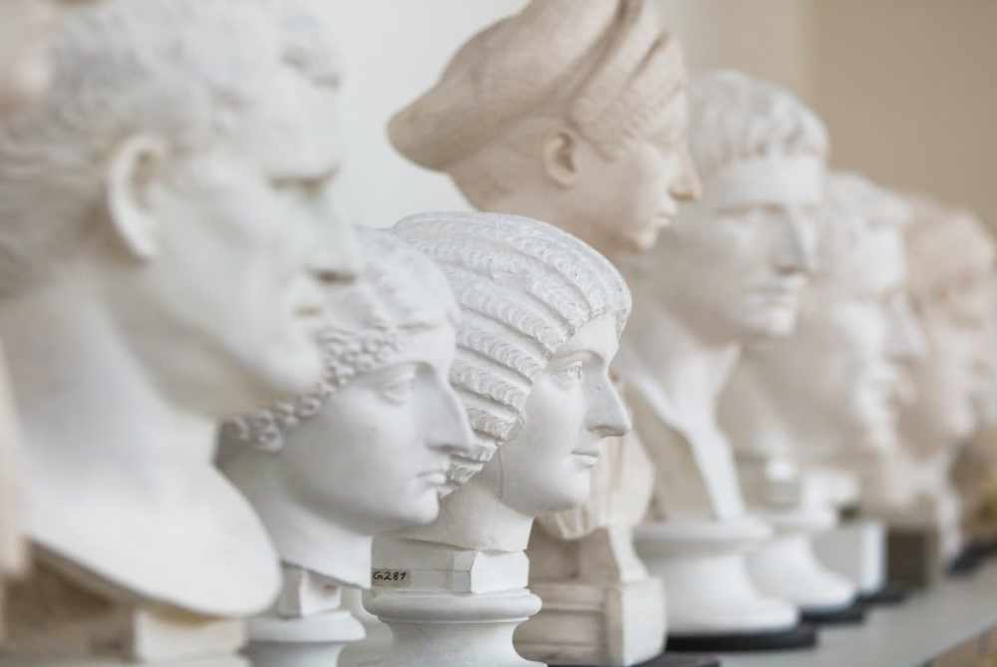
Anwendungs-beispiele
Beispiel für eine Zwischenfolie

Slide 38
Noch Eine Zwischenfolie mit Bild
Untertitel

Slide 39
Zwischenfolie ohne Bild
Untertitel

Slide 40
Anwendungsbeispiel
AUFZÄHLUNG
Hier könnte sich Ihr Fließtext befinden. Fließtexte sind natürlich nicht schlecht – aber in einer Präsentation auch nicht optimal. Haben Sie ein Herz für Ihre Zuhörer und bedenken Sie folgende Tipps:
Lange Texte vermeiden,
Schlagwörter oder kurze Wortgruppen hervorheben,
Aufzählungen verwenden.

Slide 41
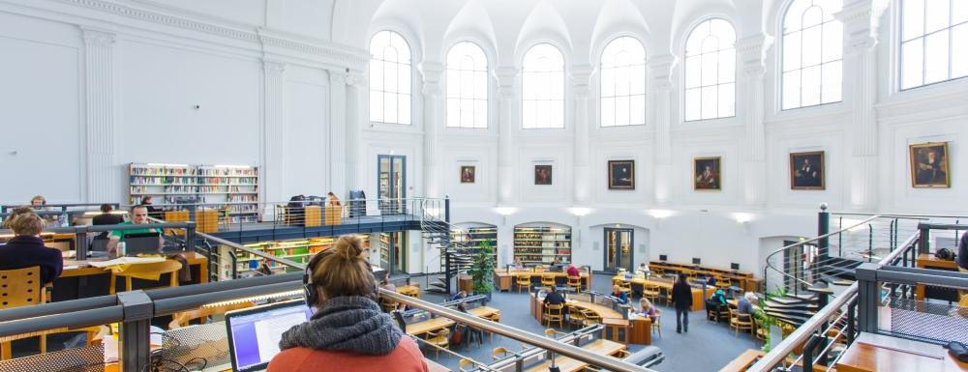
Anwendungsbeispiel
Hier könnte sich Ihre Bildunterschrift befinden – Arial, 12pt, 50 % Schwarz

Slide 42


Slide 43

Anwendungs-beispiel
Vergessen Sie bei der Verwendung von Bildmaterial bitte nicht die Angabe der Quelle und vergewissern Sie sich, dass Sie über die nötigen Bildrechte verfügen.
Kennen Sie schon unseren Fotoservice?
Quelle: Universität Leipzig / Name des Fotografen

Slide 44
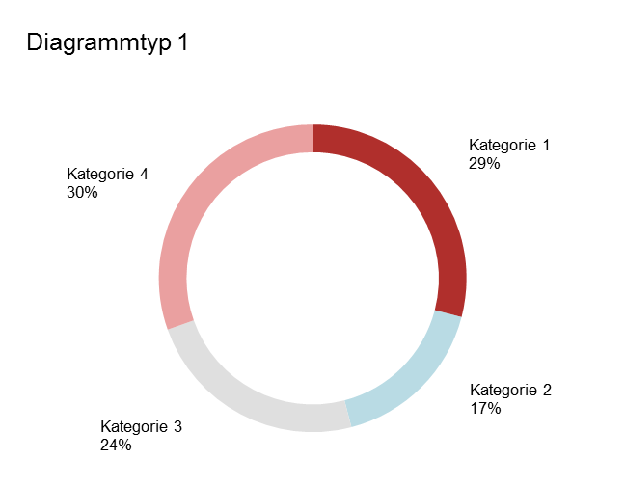
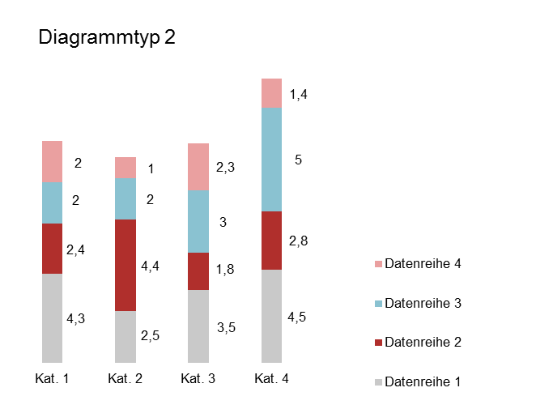
Anwendungsbeispiel
DIAGRAMME
Gesamt
14,8
Abbildungsunterschrift
Abbildungsunterschrift

Slide 45
Vielen Dank!
Name
Einrichtung
Adresse einzeilig
T +49 341 97-xxxxx F +49 341 97-xxxxx
xxx@uni-leipzig.de
www.uni-leipzig.de

